Slide 1
Murder Mystery Party
Yuxuan Qiu

Slide 2

Research Question:
Do players who employ bluffing strategies in social deception games outperform those who do not bluff in terms of individual performance and game outcomes?

Slide 3
Bluffing
Bluffing in the context of social deception games can be defined as a strategic behavior where a player intentionally misleads or deceives other players about their true intentions, roles, or game-related information, with the aim of achieving an advantage.

Slide 4
Game Observation:
Independent Variables:
Effectiveness of Bluffing: Rate the bluffing performance from 1- 10
Dependent Variables:
Bluffing player:Yes or No or Maybe
Individual player scores
Bluffing attempts
Success bluffing times
First time bluffing success:Yes or No
Bluffing success rate

Slide 5
Methodological Plan:
Pre-game Survey:https://forms.gle/iSEmFbJiFaZ4nrcd6
Game Observation
Post-game Survey:https://forms.gle/Astu2YZh4zMczxHk7

Slide 6
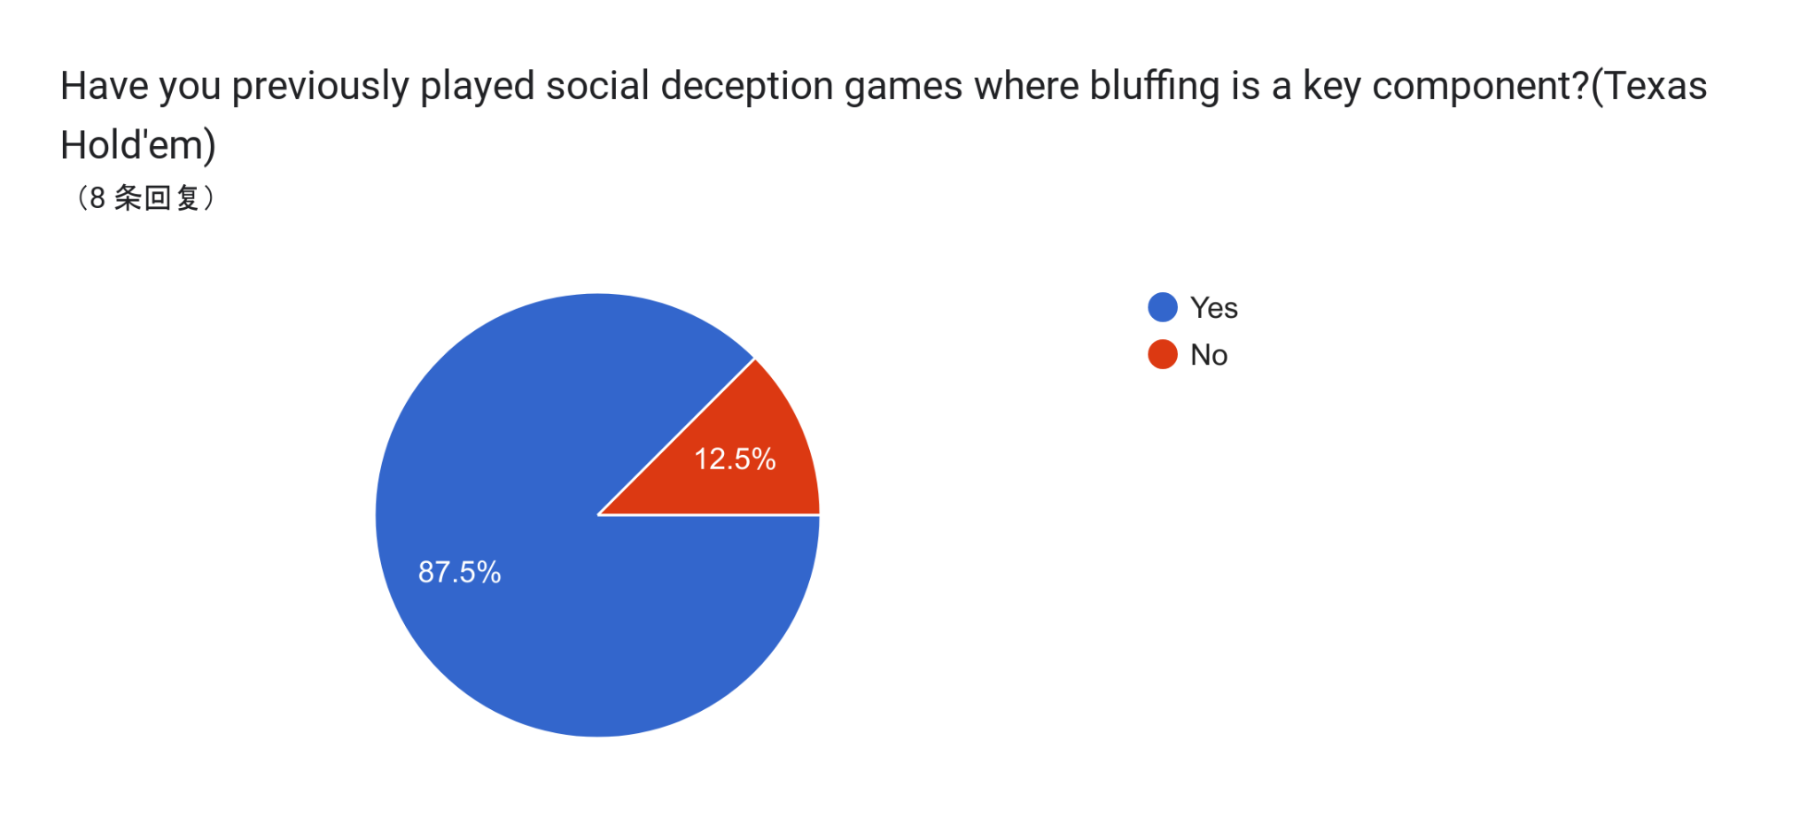
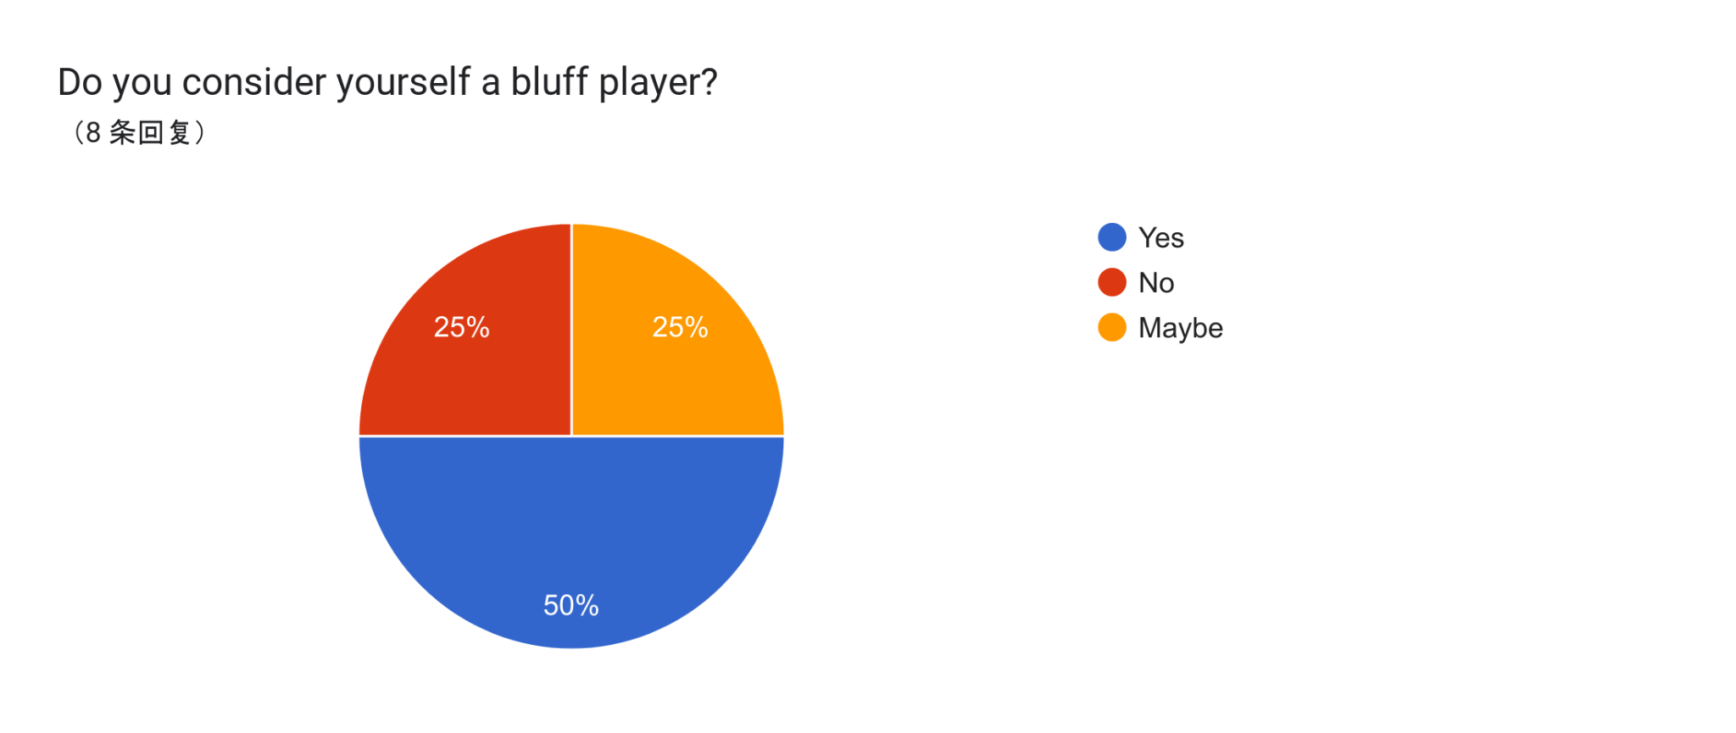
Pre-survey

Slide 7
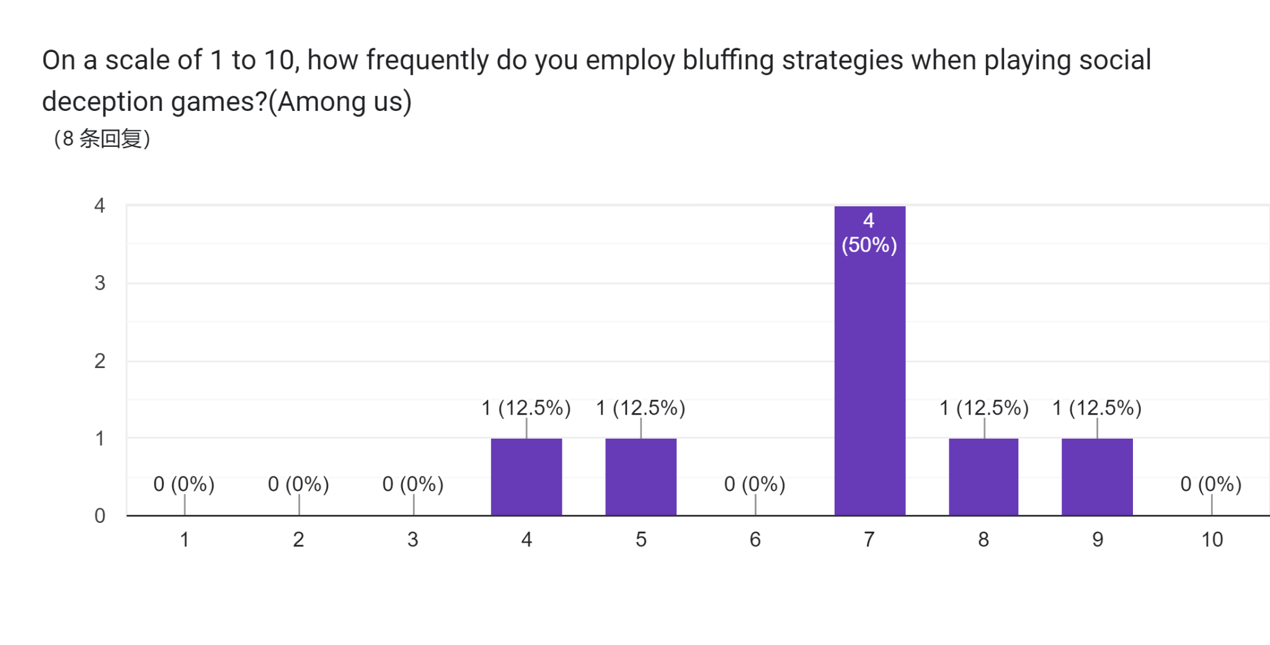
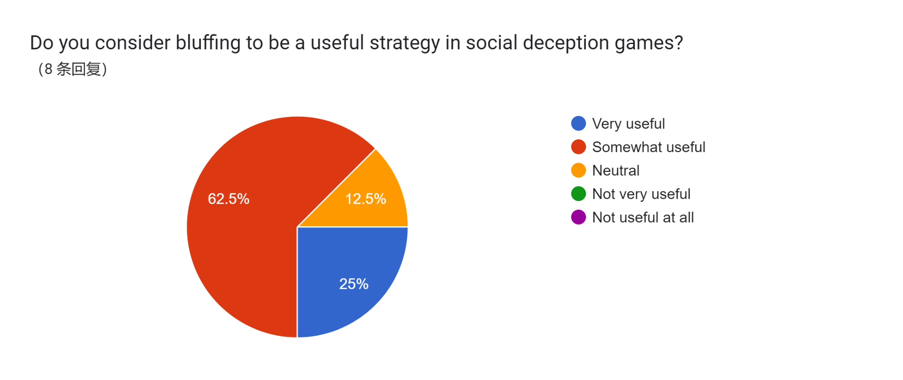
Pre-survey

Slide 8
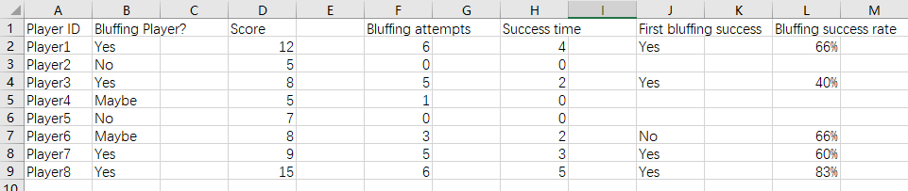
Game Observation Result
Bluffing player percentage:50% - 75%
Bluffing player average score: 9.5 - 11
Non-Bluff Players: 6 - 6.25

Slide 9
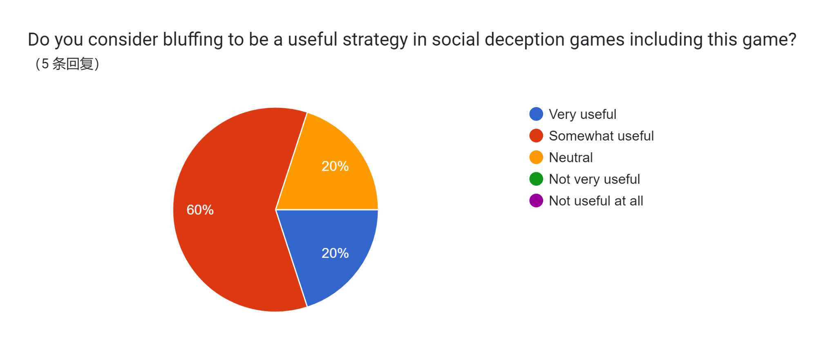
Post-survey
What do you think is the secret to winning this game?
Answer: Co-player’s description about how good or bad their cards are. 2. My own cards if it’s good or bad. 2. How others predict their winning. 3. How to bluffing to win the game.
To win the game, pick big numbers and predict possible modus operandi. If you want to predict a win, don’t choose unlikely modus operandi and small numbers card.
Choose the cards that not related with the case. Throw away the cards related to the case. Predict my winning about 0-1 times.
Luck. You can win anytime with a good hand.

Slide 10
Result
According to my research questions bluffing players are able to win and get high scores more easily than players who don't bluff. Especially if you don't know each other's strategies, the first bluff has an 80% success rate, and the most common scenario occurs when people asks to play a suicide card together in the first round, and often only one person plays a suicide card, which leads to a win for the person who played the side card.But overall the results of the game show that bluffing players are more likely to win the game.

Slide 11
Future Plan
1.Recruit more players to provide more reliable data conclusions
2.Improve the quality of the deduction story by making it more difficult for the player to determine the modus operandi of the deduction story by increasing the length of the deduction story and enhancing the storytelling of the deduction story.
3.Developed as a card game and web mini-game as a social type of game.
4.Add more method cards and Schema Card

